Slide 1

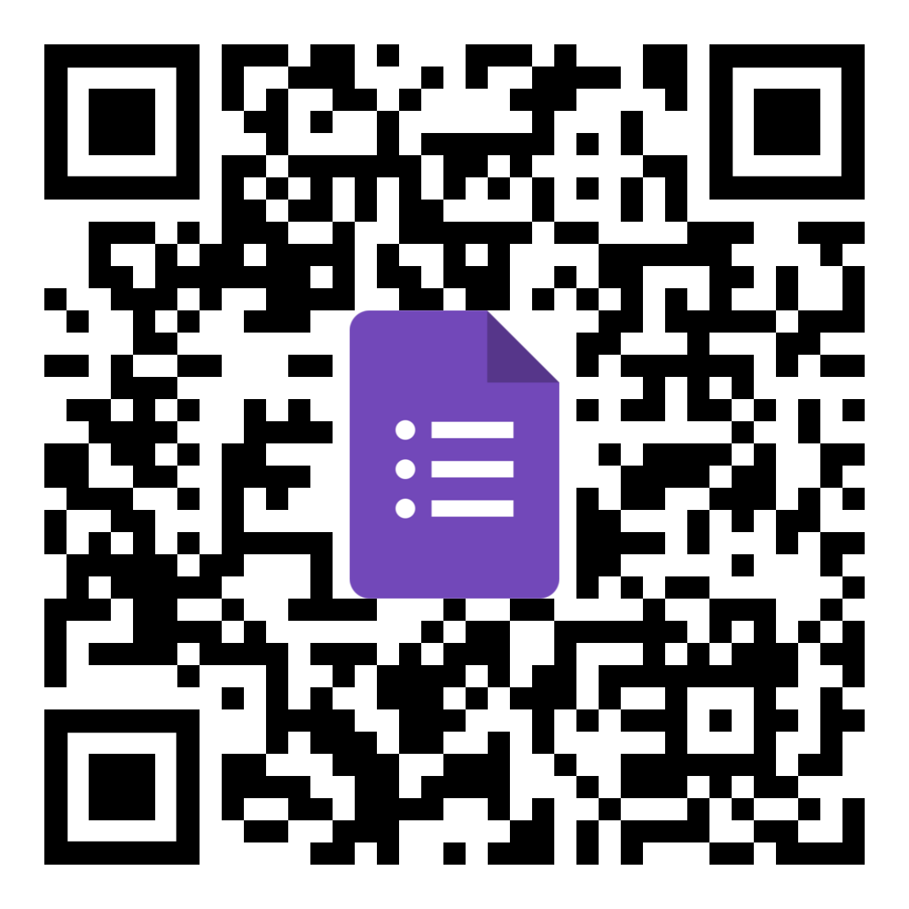

Contact Information
Machine Learning Approaches for National Student Clearinghouse
Steven Sherrin, Wentworth Institute of Technology
Statistics,
Methods, & Code
Do You Want To Collaborate?
Connect on LinkedIn

Slide 2
Contact Information
Machine Learning Approaches for National Student Clearinghouse
Steven Sherrin, Wentworth Institute of Technology
Statistics,
Methods, & Code
Do You Want To Collaborate?
Connect on LinkedIn

